Slide 1
How States Can Protect Environmental Health: Part 1
Name of course:
Date:

Slide 2
Learning objectives
1. Define and describe the field of environmental health.
2. Explain how and why the field of environmental health fragmented.
3. Compare and contrast the roles of federal, state and local government in protecting environmental health.
4. Debate the merits of regulating environmental health at the federal versus state levels.

Slide 3
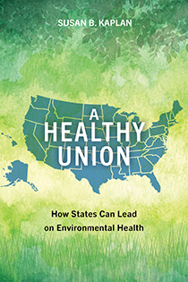
Assigned text
For classes addressing this topic, read the book A Healthy Union: How States Can Lead on Environmental Health, by Susan Kaplan, published by Island Press, November 2025, https://islandpress.org/books/healthy-union#desc.
.

Slide 4
Definitions and background

Slide 5
What is environmental health?
Environmental health is the science and practice of preventing human injury and illness and promoting well-being by
  identifying and evaluating environmental sources and hazardous agents and;
  limiting exposures to hazardous physical, chemical, and biological agents in air, water, soil, food, and other environmental media or settings that may adversely affect human health.
- National Environmental Health Association

Slide 6
Discussion questions
Give an example of an environmental health issue in the news.
  In what way does it fall within the definition of environmental health?
  Does this issue fit within medicine, public health, environmental policy, or another professional field? Why?
  What agency or agencies regulate this issue?

Slide 7
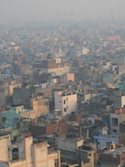
Contaminants can be found in:
Soil/land
Water
Air
Food
Photo: Smog Over Delhi, WHO

Slide 8

Potential routes of exposure Photo: BBC
Inhalation
Skin absorption
Ingestion
Across the placenta

Slide 9
Environmental health issues
Indoor and outdoor air quality
Soil quality
Water quality
Workplace safety and health
Food safety
Vector/pest control
Toxic chemicals
Lead poisoning
Built environment
Emergency planning
Climate change

Slide 10
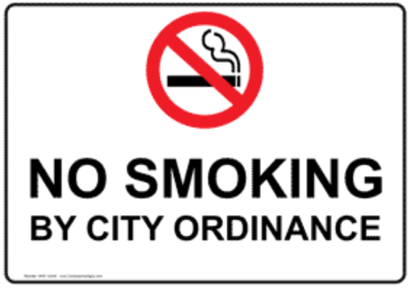
What is a policy?
“A definite course or method of action selected from among alternatives and in light of given conditions to guide and determine present and future decisions” (Merriam-Webster Dictionary)
-The considered decision of an agency or organization
-In writing
-Binding / enforceable
-Applies to a group of people

Slide 11
More about policies
Other terms: act, statute, rule, regulation, ordinance
Examples of public policies: Clean Air Act; regulations developed by U.S. EPA under the Clean Air Act; state speed limits
Examples of private policies: university plagiarism policy, corporate sexual harassment policy

Slide 12
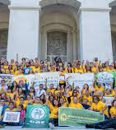
It’s not just policy enactment
It can take a long time to enact a policy. There has to be sufficient support for it. This often starts with information, education, and demonstration projects.
Strong support can help to ensure that an enacted policy is also implemented and enforced.
Photo: California Environmental Justice Alliance

Slide 13
Role of federal, state and local government in environmental health policymaking

Slide 14

The Commerce Clause of the U.S. Constitution
It gives Congress the power “to regulate commerce…among the states.”
This is very broad. Consider a shirt or a coal-fired power plant – from materials extraction to delivery, they cross many state lines.

Slide 15
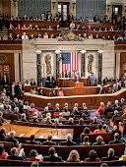
The Supremacy Clause of the U.S. Constitution
Acts of Congress are “the supreme Law of the Land.”
According to the Supreme Court, this allows federal pre-emption (overriding) of state law. But in practice, this varies from law to law and takes place mainly when a federal law specifically precludes a state from legislating on an issue.
Photo: Science

Slide 16
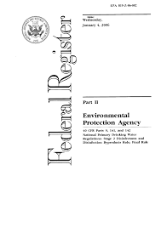
Federal laws and regulations
Congress enacts laws.
Agencies promulgate rules and regulations, which add detail to laws. Agencies follow the process required under the Administrative Procedures Act (APA). The APA prescribes a “notice and comment” process in which the public can provide input to agencies via submitting comments and speaking at hearings.

Slide 17
State environmental health role
States have roles in federal laws, like developing state implementation plans under the Clean Air Act.
They also have specific responsibilities in areas including disease surveillance, emergency preparedness, brownfields, and food safety.

Slide 18
State environmental health role, cont’d
Some states have laws that go beyond federal protections. Examples:
  State of Washington OSHA: Its requirements go beyond those of federal OSHA.
  California Proposition 65: It requires warning labels on items that could cause cancer or birth defects.
This will be the main focus of these lectures.

Slide 19
Discussion questions
What are the pros and cons of environmental health policies being made at the federal level versus the state level?
Give an example of a federal environmental health law or regulation that falls short of providing robust health protection.
  What is the nature of the shortcoming?
  What could be the reason for this?

Slide 20
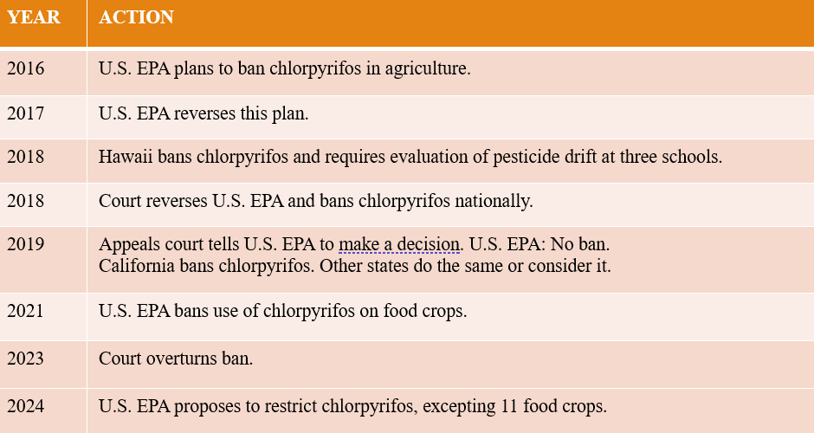
Chlorpyrifos as an example of laws flip-flopping between federal and state levels
Chlorpyrifos is an insecticide used in agricultural that is linked with neurodevelopmental problems in children.

Slide 21
What about local government?
Functions include lead concerns, vector-borne disease, indoor air quality.
Local governments can also try out new programs and policies, which can influence state policies.
Takoma Park, Maryland enacted an ordinance banning cosmetic use of pesticides. Advocates used that success to pass a similar law in Montgomery County, MD, in which Takoma Park is located.

Slide 22
Environment-health fragmentation

Slide 23
1920s: The split starts
Environmental movement
Natural resources conservation Improved sanitation in cities
During the Progressive era, conservationists successfully pushed for the federal government to increase its role in managing natural resources. Sanitary efforts were based in cities and more diffuse.

Slide 24
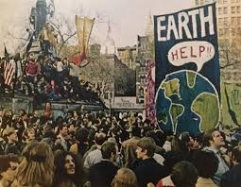
1970s: The environmental movement grows
Congress passes laws including the Clean Air Act, Clean Water Act, and hazardous waste laws, and establishes the U.S. Environmental Protection Agency. Public health fails to develop a similar, broad-based movement.
Photo: Zinn Education Project

Slide 25

Consolidation at environmental agencies
When the EPA was established, programs at federal health agencies that addressed areas like air and drinking water quality were moved to EPA.
The consolidation was meant to strengthen environmental health protection. Instead, it reduced attention to the public health aspects of environmental issues.
This pattern was replicated in states.

Slide 26
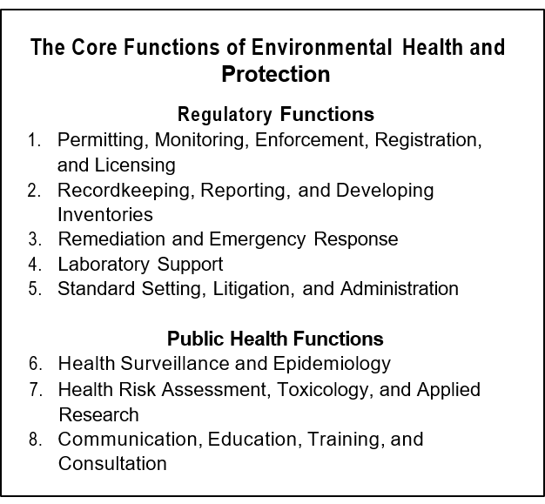
Environmental and health agency functions
Source: Burke, shalauta, tran and stern, “The Environmental Web”

Slide 27
State environmental health structure
Due to this split, environmental health programs are now housed at a range of state agencies, such as:
  environment and natural resources
  agriculture
  labor
  health
  An environmental agency might not have expertise in or prioritize health aspects of its work, while a public health agency may lack understanding of impacts of pollution and toxics on health.

Slide 28
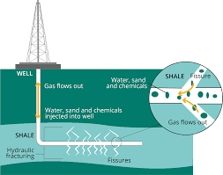
Challenges created by silo-ing of environment and health
Consider hydraulic fracturing. In an example state, regulations are developed by the natural resource agency – but does it have expertise about potential toxic air and water emissions to nearby residents?
Graphic: European Environmental Agency

Slide 29
Additional contributors to slowing of federal environmental health protections
Partisan divisions. For example:
  Clean Air Act Amendments of 1970: Passed 374-1 in the House and 73-0 by the Senate, signed by President Nixon
  Inflation Reduction Act of 2022 (included support for renewable energy to address climate change): Passed the House 220-207 and the Senate 51-50, signed by President Biden

Slide 30
Additional contributors
State environmental agencies that have roles in carrying out federal laws tend to have more regulatory authority and funding than state public health agencies.
Industry influence often leads to watering down of federal environmental health protections.

Slide 31
Discussion questions
Describe how environment-health fragmentation might play out in a situation of a public library using cleaning products that are causing occupants to get headaches.
Questions:
  Who might be responsible for addressing this problem?
  What knowledge and training might they have or lack?
  Who do you think should be involved in order to resolve the issue?

Slide 32
Enter the States

Slide 33
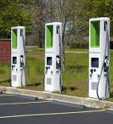
Pre-emption exemption: California waiver
California has historically led the states on environmental health protection. It was the only recipient of a waiver under the Clean Air Act that allows it to set motor vehicle emission standards more protective than federal standards. Seventeen states and D.C. have adopted California’s standards.
Photo of EV charging infrastructure: CalMatters

Slide 34
Why do states enact protections?
  Culture: Some have a culture of environmental health protection.
  Wealthier states tend to spend more on environmental protection.
  Economy: Contributors to the state’s economy have an impact.
  Politics: Democrats support environmental laws more often, but conservative states pass environmental laws that use framing like incentives instead of mandates. It is not just a “red state/blue state” dynamic.

Slide 35
Discussion question
What are the impacts of different states having differing state environmental health policies? Use California’s emission standards as an example.

